Slide 1
Week 3: Bluetooth module
Week 3: Link to slides here https://tinyurl.com/zd6smkt9

Slide 2
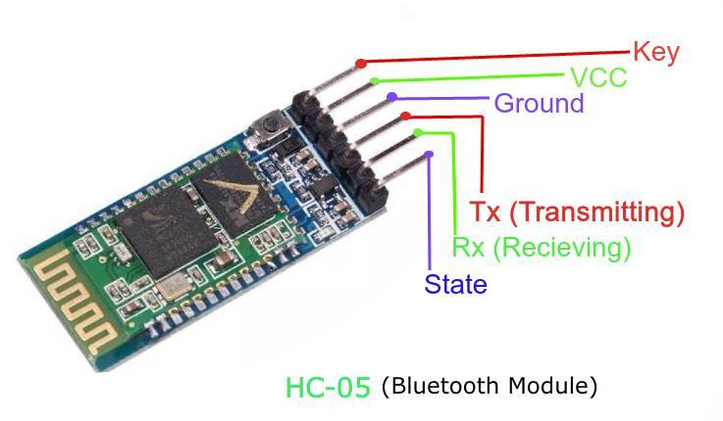
The HC-05 Bluetooth Module
Allows for two way wireless function
Integrates Bluetooth into project
Controlled by any BT device
Ability to control other BT modules (slave & master mode)
Default is Slave mode (only receives, doesn’t send)

Slide 3
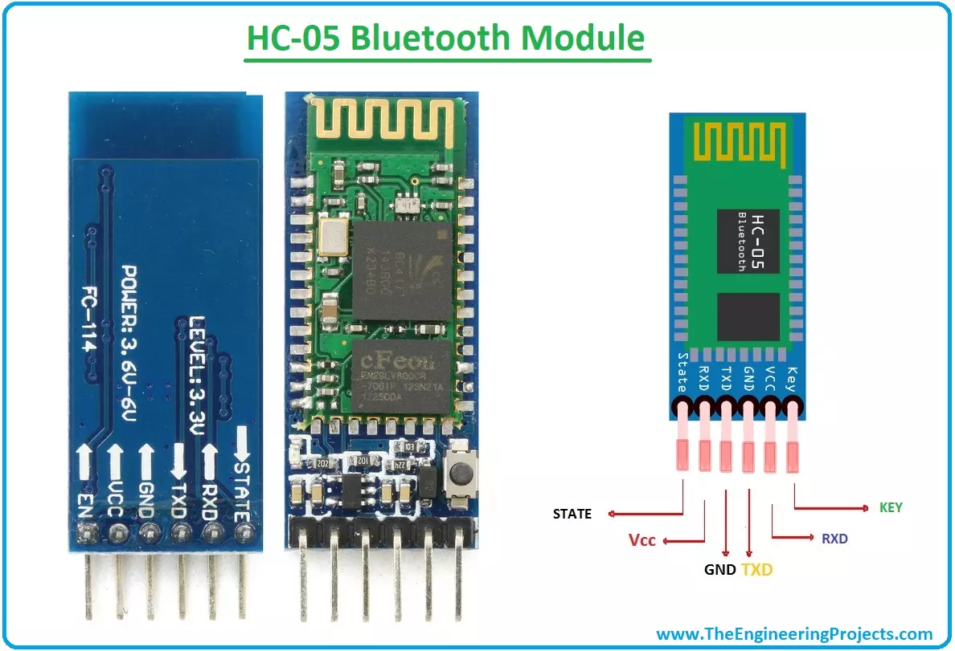
HC-05 Bluetooth Pin Layout
Key/EN = toggles Data Mode (Slave) or AT Command Mode (Master)
VCC = connects to 5V+ power supply
TX (Transmitter) = transmits data serially to micro-controller (module → Arduino)
RX (Receiver) = broadcasts data serially to module (Arduino → module)
State (w/ LED) = checks if module is working properly
LED = does the following
1 blink in 2 sec: Module has entered Command Mode
Repeated Blinking: Waiting for connection in Data Mode
2 blinks in 1 sec: Connection successful in Data Mode

Slide 4
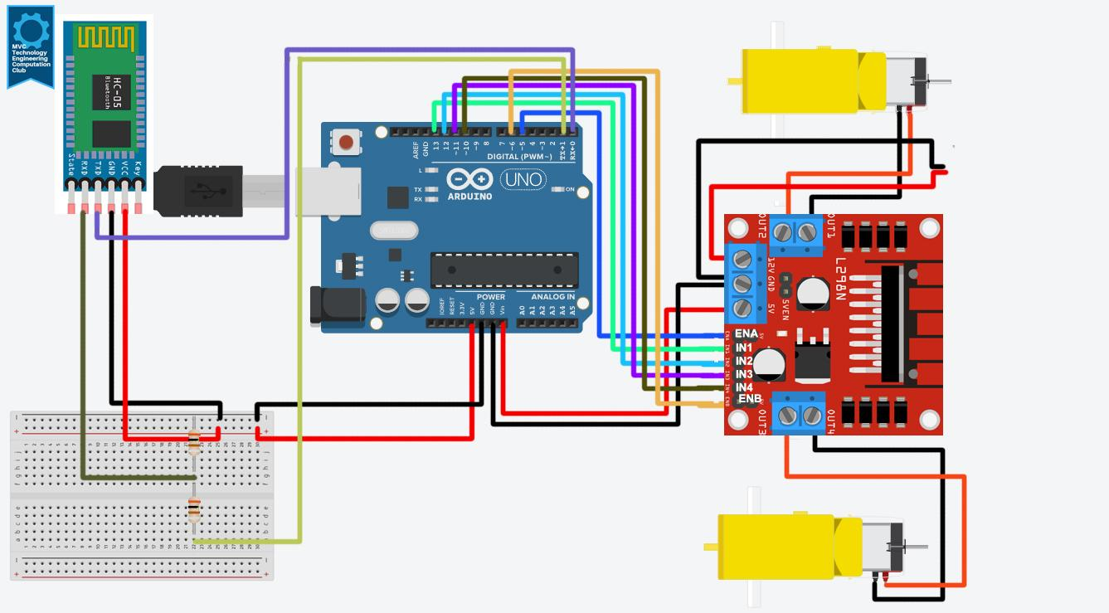
Example: Control Motors w/ BT module
DRIVER TO ARDUINO
MOTOR TO DRIVER
BATTERY TO DRIVER
BLUETOOTH TO ARDUINO
ENA IN1 IN2 IN3 IN4 ENB 5V GND | 5 13 12 11 10 6 5V GND
A
CLICK TO SEE LINK TO IMAGE
A RED A BLACK B RED B BLACK | OUT1 OUT2 OUT3 OUT4
RED BLACK | 12V GND
B
TXD RXD GND VCC | RXD TXD GND 5V

Slide 5
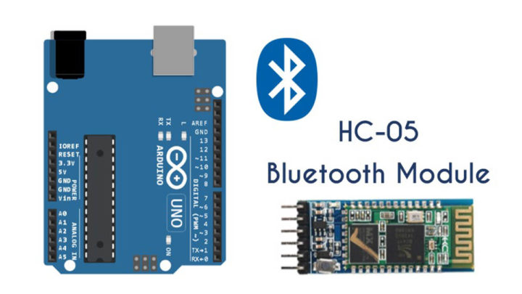
Setting up the program for this example
https://tinyurl.com/yhsmed53
Above is the link to the program.
One thing to note is BEFORE UPLOADING the program to the Arduino DISCONNECT the RXD and TXD pins from the arduino
Otherwise you will be unable to upload the program to the arduino

Slide 6
How to connect to the bluetooth module
First you want to make sure it is flashing red meaning its on
Next we must find the bluetooth module in our bluetooth settings on windows
Click on Add Bluetooth or other device and click Bluetooth
It should be named HC-05
If prompted for a password you can either type 1234 or 0000
Once connected it should be blinking twice repeatedly every 1 second.
Next we need to find the COM port through which the Bluetooth module communicates
Open up the control panel by typing control in the windows search bar
Click on Hardware and Sound
Then click on Devices and Printers and right click on the HC-05
Then click on Hardware and and you should be able to see the COM port
You might need to expand the Name tab to see it fully
With the bluetooth module connected and finding the correct COM port, we now head over to the IDE

Slide 7
Arduino IDE Section
Here on the IDE we’re going to do the following
Go to Tools then click on Port and set the COM port to the one that we had found previously.
Once the port is set go to Tools again and this time click on Serial Monitor and set the Buad rate to 9600 as this is the rate that is set in the Arduino code to communicate with the bluetooth module
Also set your carriage return as New line (This is the box on the left side of Buad rate)
Once everything is set correctly you can type F to move the motors forward or S to stop all the motors.

Slide 8
Other example videos and info
Arduino and HC-05 Bluetooth Module Tutorial | Android Smartphone & Laptop Control
Adding Bluetooth to Your Arduino Project with an HC-05 or HC-06 Bluetooth Module (Very loud intro so turn it down if you watch it)
Using AT Commands to Set Up Your Bluetooth Module : HC-05 and HC-06

Slide 9
SOURCES for these slides
All about HC-05 Bluetooth Module | Connection with Android - GeeksforGeeks
HC-05 Bluetooth Module Pinout
HC-05 Bluetooth module
Arduino and HC-05 Bluetooth Module Complete Tutorial
How To Configure and Pair Two HC-05 Bluetooth Modules as Master and Slave | AT Commands

